Slide 1



5 Domains of Writing

Slide 2
Conventions
Conventions is the grammar, mechanics, spelling, usage and sentence formation used in writing.

Slide 3
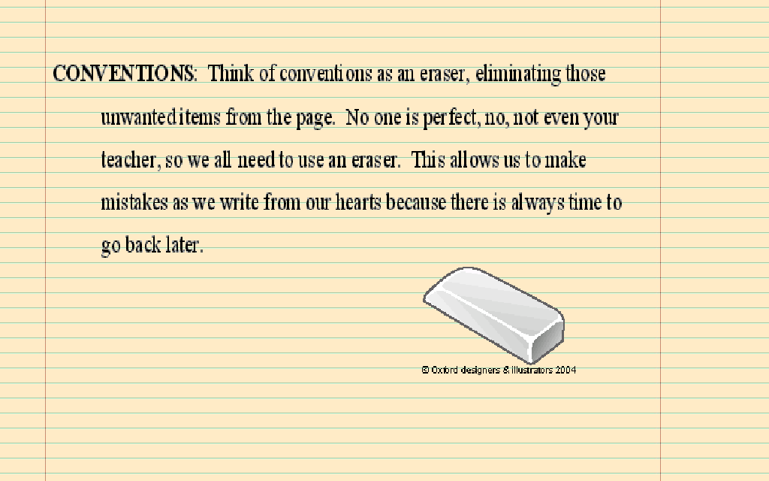

Slide 4
How do you write using conventions properly?
A writer must write with evident control of grammar, mechanics, spelling, usage and sentence formation.

Slide 5
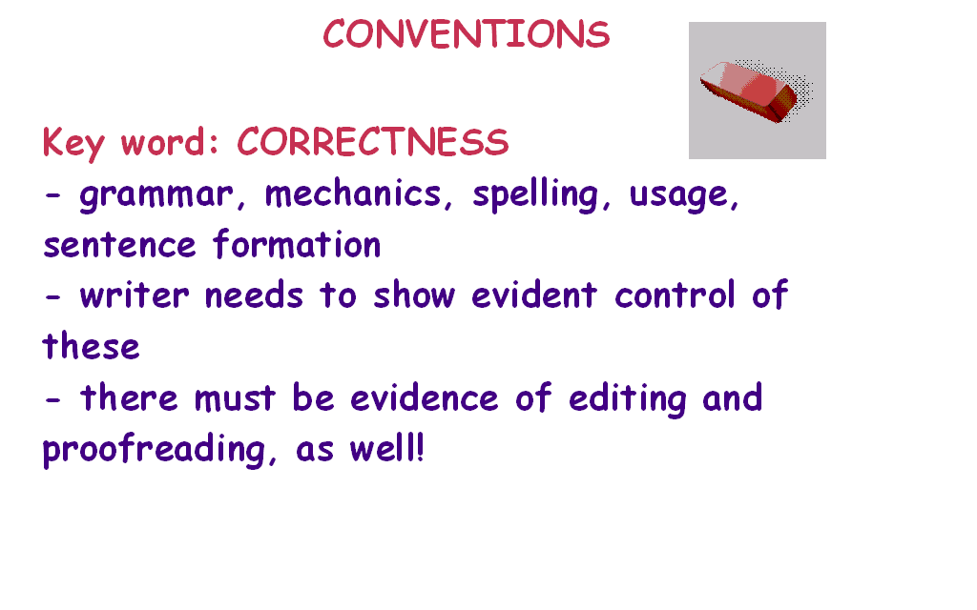

Slide 6
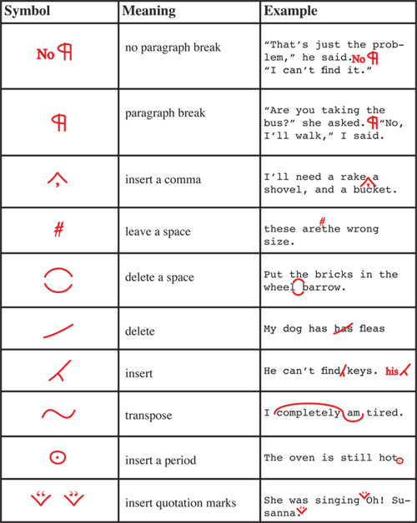

Slide 7
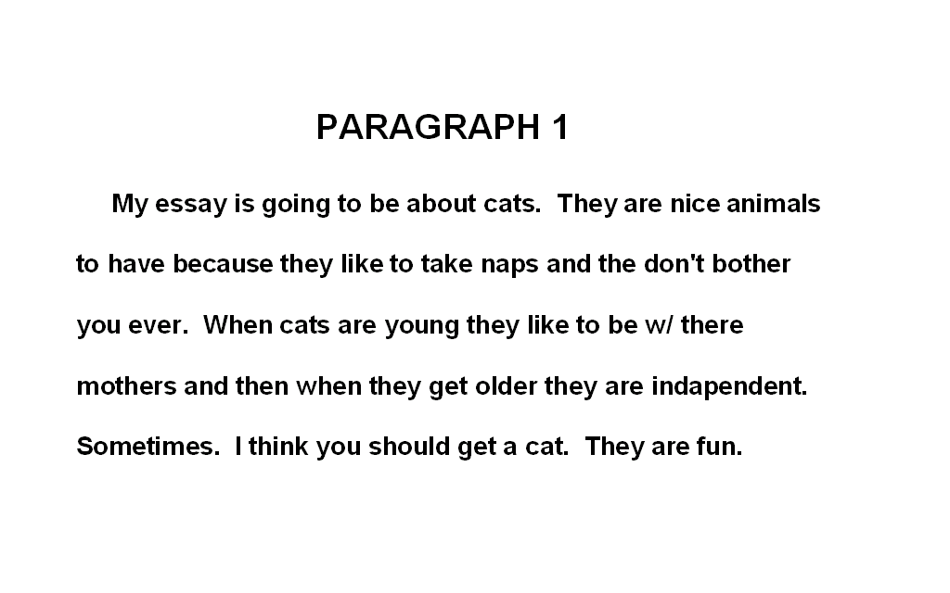

Slide 8
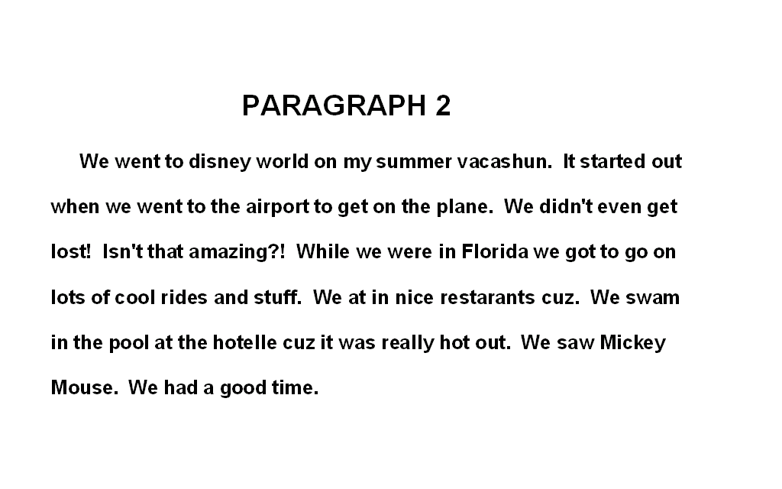

Slide 9
